Slide 1
Voice command and control system for Unmanned Aerial and Ground Vehicles
External Guide: Dr. K.Raghavendra (Scientist ‘SG’, ADRIN (ISRO))
Internal Guide: Dr. K. Ram Mohan Rao (HOD (Information Technology))
Team A37
Team Members:
P Anurag Varma (1602-18-737-006)
Sonali Godavarthy (1602-18-737-047)

Slide 2
Contents
Objective
Introduction
Literature Survey
Proposed System
System Design
Results
Future Scope

Slide 3
Objective
The main objective of the project is to propose a system to control a UAV/UGV with voice commands.
Proof of concept for UAV
This is carried out in two parts:
Development of DL model for Speech Recognition
Real time application by integrating this model into UAV/UGV device
Voice commands like on, off, up, down, left, right, etc can control the device
Command and control for long distances using cellular networks
The command can be captured after detecting the word “Milind”
The action is performed according to the command
A voice command is given through a microphone

Slide 4
Introduction
Demonstration of idea of speech control system of UAV/UGV device.
Generally, a drone is controlled using joystick to control their motion.
There are four main drone controls: Roll, Pitch, Yaw, Throttle
Dealing with the control of drone using voice. The action of drone is performed based on the command given.
E.g. Let us say we want to move the drone(named Milind) right, we say “Milind right”

Slide 5
Literature Survey
S.No. | Title | Author | Summary
1. | Quadcopter Control Using Speech Recognition | H Malik S Darma S Soekirno | Using Mel frequency cepstral coefficient(MFCC) and RNN Success rate of 80%
2. | Unmanned Aerial Vehicle Control through Domain-Based Automatic Speech Recognition | Ruben Contreras Angel Ayala Francisco Cruz | Algorithm for command interpretation using Spanish and English Cloud-based approach Achieved an accuracy of 74.81% for English Achieved an accuracy of 97.04% for Spanish
3. | Controlling a Drone using Virtual Assistant Amazon Alexa | Parisa Chandrasekhar Mohammed Sabah | Build a drone that is controlled by using a virtual assistant called Amazon Alexa. Amazon helps to create voice recognition understandable by the system. Succeeded 70% of the work and achieved good results
4. | Control System for Unmanned Aerial Vehicles | Ondrej Spinka Stephan Kroupa Zdenek Hanzalek | dealing with autopilot design for autonomous Unmanned Aerial Vehicles Control algorithms, based on PI, LQG and SDRE approaches Navigation of 2-axis only

Slide 6
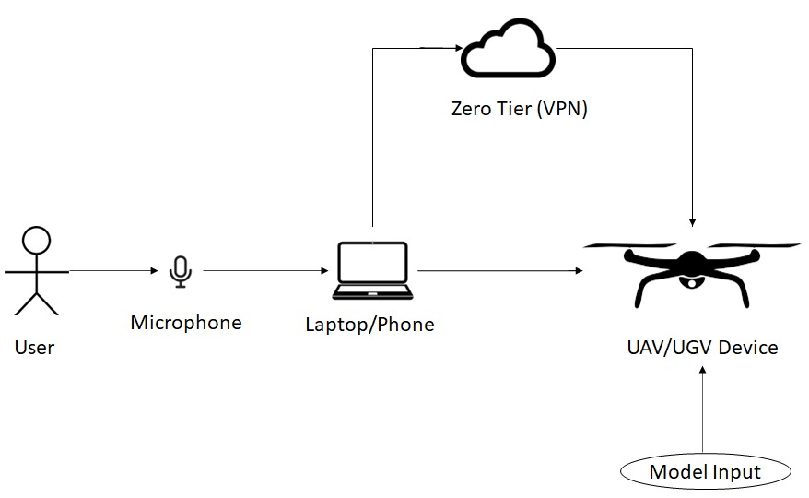
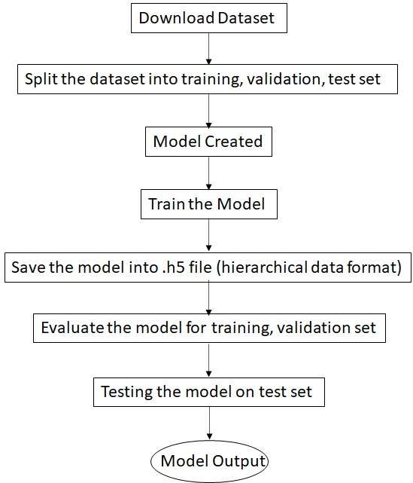
Proposed System
Architecture Diagram

Slide 7

Use Case Diagram
Speech Recognition Model
Command Controlling Model
Collect Data from Dataset
Give Voice Command
Train the Data
Run the Model
Validate the Data
Give Output
Data
IOT Device
User
Test the Data
Give the output to Drone

Slide 8
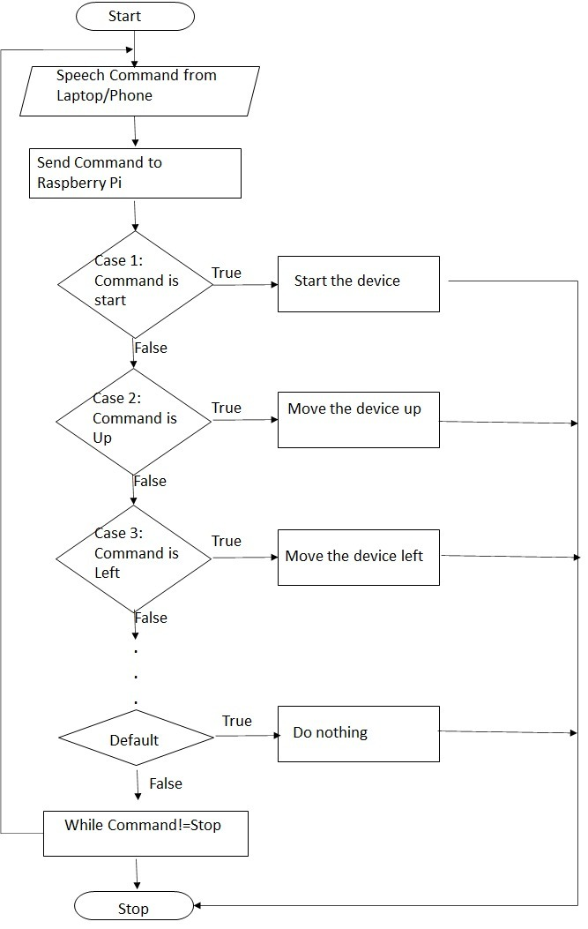
Data Flow Diagram
Start
Speech Command from Laptop/Phone
Send Command to Raspberry Pi
Case 1:
Command is start
True
Start the device
False
Case 2:
Command is Up
True
Move the device up
False
Case 3:
Command is Left
True
Move the device left
False
Case 4:
Command is Forward
True
Move the device forward
False
.
.
.
.
False
True
Default
Do nothing
False
While Command!=Stop
Stop

Slide 9
System Design
The dataset used is Google speech Command Dataset V2 (sd_GSCmdV2) – Audio dataset of spoken words in wav format
Used to train and test the model
Training dataset contains 20 commands: Background noise, bed, bird, dog, down, eight, go, house, left, marvin, nine, no, one, seven, Sheila, tree, two, wow, yes. It has 39896 recordings.
Testing dataset contains 12 commands: silence, unknown, down, go, left, no, off, on, right, stop, up, yes .It has 3081 recordings.
All 35 commands: unknown/silence, nine, yes, no, up, down, left , right, on, off, stop, go, zero, one, two, three, four, five, six, seven, eight, backward, bed, bird, cat, dog, follow, forward, happy, house, learn, marvin, sheila, tree, visual, wow
A custom dataset is used to improve the accuracy, which includes the following 23 commands: nine, yes, no, up, down, left , right, on, off, stop, go, zero, one, two, three, four, five, six, seven, eight, backward, follow, forward

Slide 10
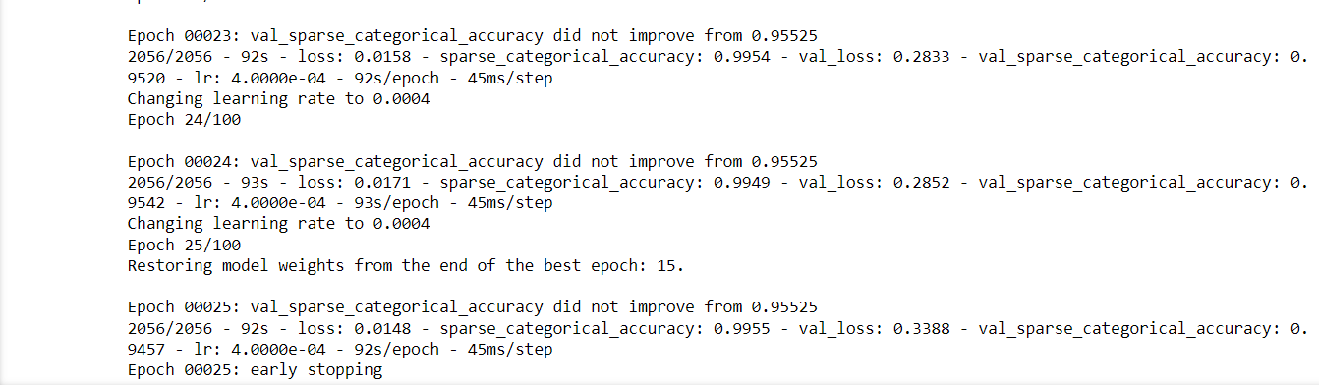
Model Development
The accuracy obtained is 95.5% with number of epochs as 25
The number of epochs was set to 100, but due to early stopping it stopped at 25 epochs
The time taken to train the model took around 60 minutes.
The 23 words is labelled as classes for classifying the speech command

Slide 11
Wakeup Command Recognition
Method to request attention when a certain word is spoken
Here, the command is “Milind”
PocketSphinx is python library used to add the word Milind with different pronunciations to recognize the word

Slide 12

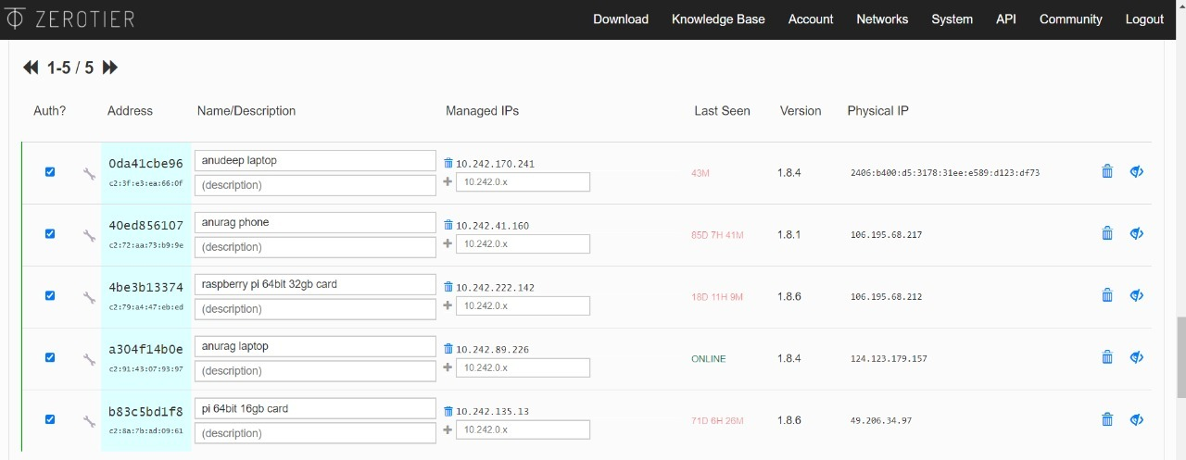
VPN and cellular module

Slide 13
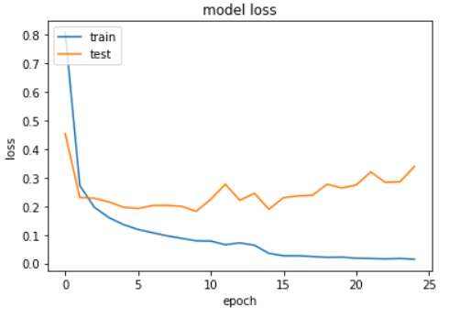
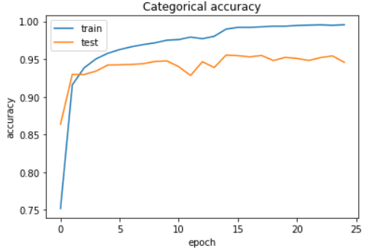
Results
Training accuracy vs Validation accuracy

Slide 14
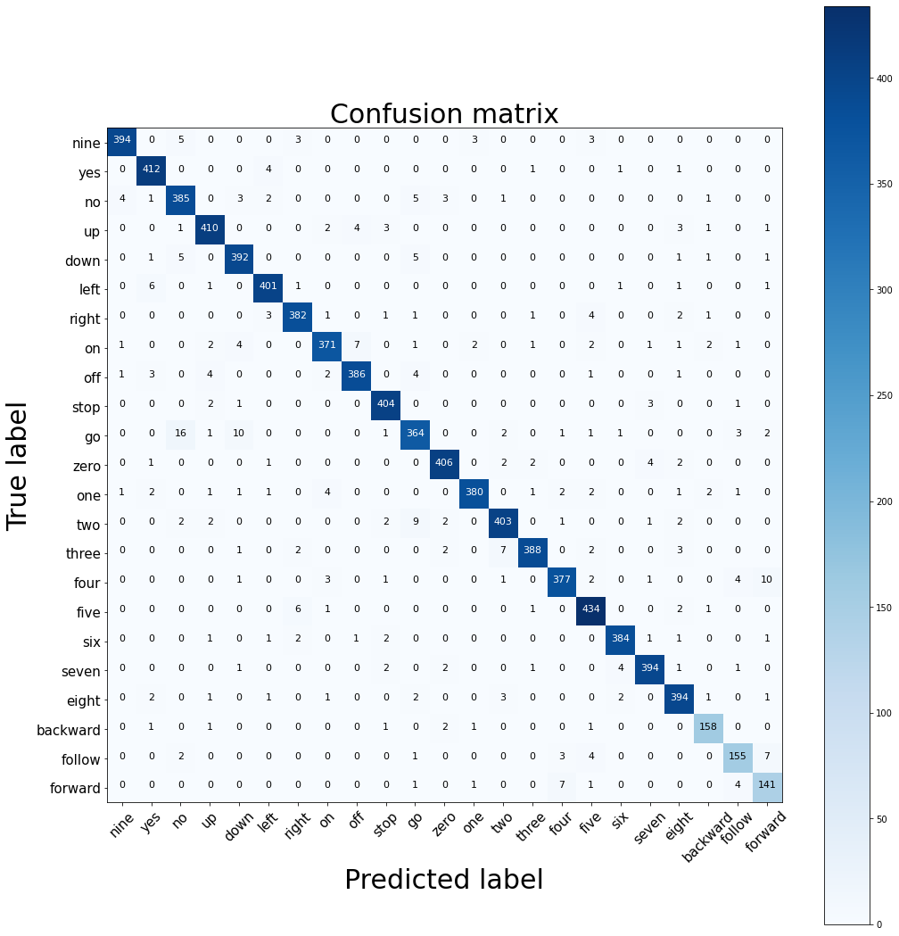
Confusion Matrix – Gives visualization of performance of a model
This matrix gives number of cases that for true label and predicted label
From the diagram, the boxes highlighted with blue colour shows True Positive i.e., the cases which is predicted correctly

Slide 15
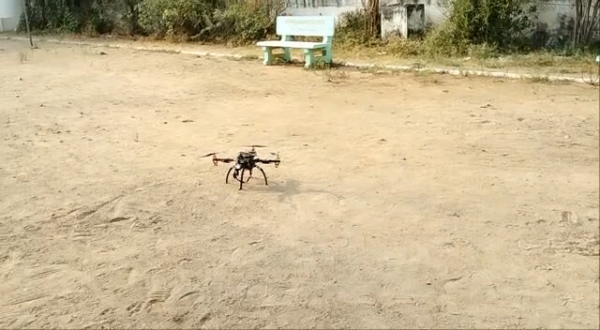
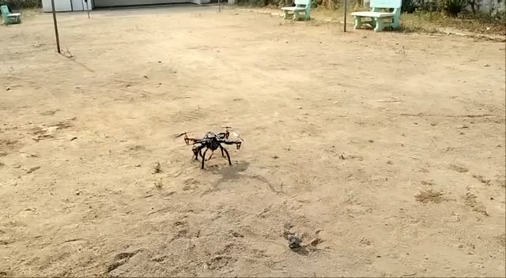

Slide 16
Future Scope
Implementation in UGV
Achieve stability to test it for UAV/UGV
FPV (first-person view) camera
Gesture controlled flying
Live location tracking
Return to user/controller can be used which makes the drone to return way back to the user/controller.
Obstacle detection and avoidance
Development of model without using GPS mode

